Slide 1



HOME TOWN
A REAL ESTATE COMPANY
HOME TOWN
REALTY
PRESENTED BY GOLD DIGGERS

Slide 2

Introduction
Real estate listing management systems-an innovative application designed to revolutionize the way real estate professionals handle property listings. In an era where efficiency, accuracy, and seamless communication are paramount, our Real Estate Listing Management System stands as the modernization for the real estate industry.
HOME TOWN
REALTY

Slide 3



Problem Statement
HOME TOWN
REALTY
An arrangement, agreement, or contract for the marketing of real property through one or more real estate agents usually for a specific period —called also listing agreement
HOME TOWN
REALTY
Data Accuracy and Integrity
Efficient Search & Filter Capabilities
Visual Presentation and Multimedia Integration
Notification and Alert Mechanisms
Security and Privacy

Slide 4

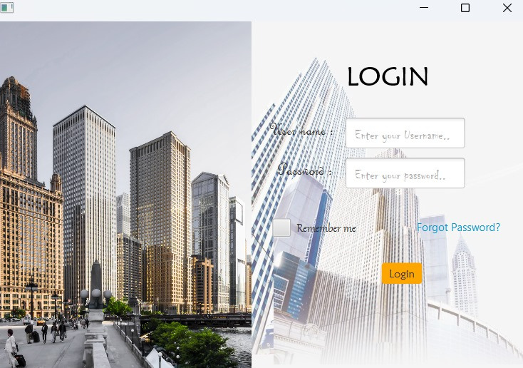
Solution
HOME TOWN
REALTY

Slide 5
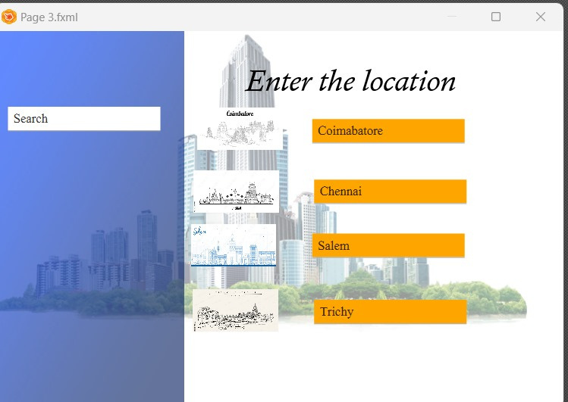
Solution
HOME TOWN
REALTY

Slide 6
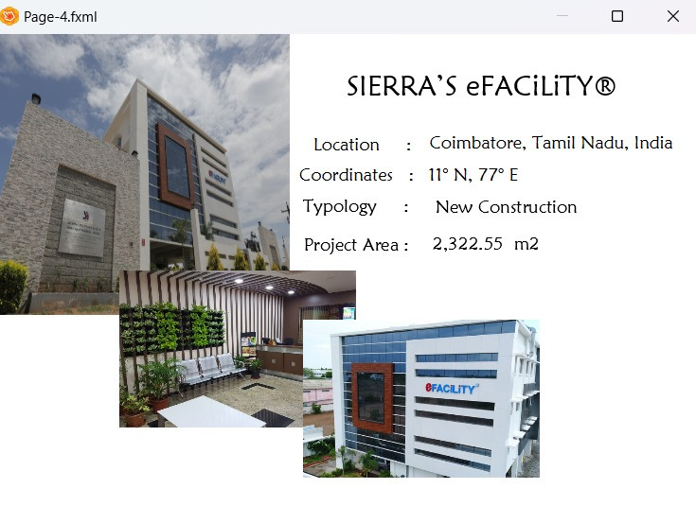
Solution
HOME TOWN
REALTY

Slide 7




Tools
HOME TOWN
REALTY

Slide 8

HOME TOWN
REALTY
Out Come
Broker Free Site
User Friendly
Expense Free

Slide 9

HOME TOWN
REALTY
THANK YOU!

